Slide 1

Smart Distributed Waste Management System
GEEKcited
GeekPie @ ShanghaiTech University
Geek
Pie_

Slide 2
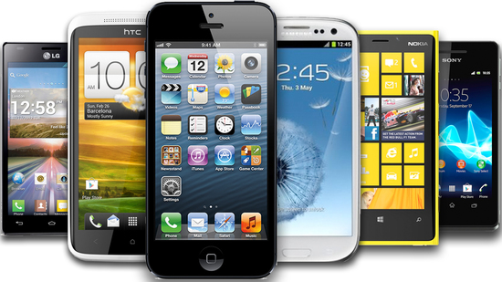

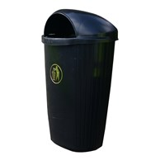
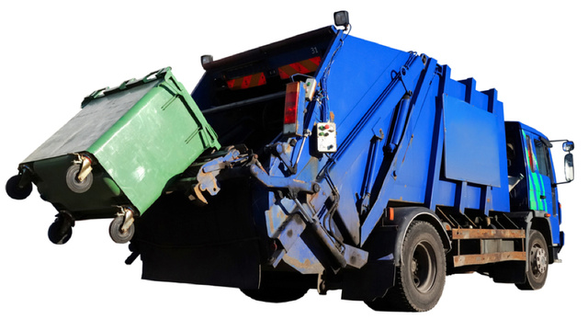
The Advent of Information Technology
Problem Introduction
... and the Primitive Methods of Civil Management

Slide 3





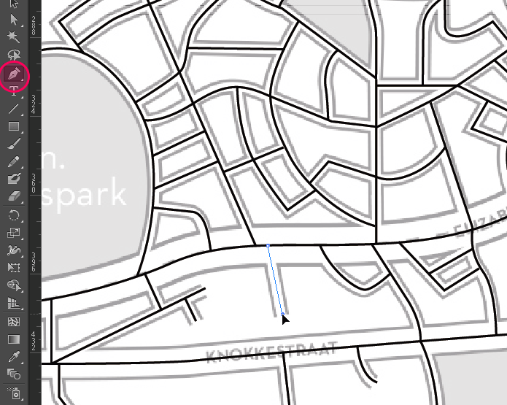
Expected Functionality

Slide 4

Alert of Misplaced Wastes
Function Demo 1

Slide 5
Upload of Waste Amount
Function Demo 2

Slide 6
Emergency Assistance
Function Demo 3

Slide 7
Status Anomaly Alerts
Function Demo 4

Slide 8
Waste Collection Path Suggestion
Function Demo 5

Slide 9
Cloud Servers
Universal Data Storage and Management
WiFi
Intel Edison
Client Architecture
Local User Interface
Sensor Data Process
Serial
Arduino Uno
Low Level
Sensor Input
Temp
Sensor
IR
Sensor
Buzzer
Alcohol Sensor
Help Button
Other Sensor
Sensors
and Indicators

Slide 10

What’s in the trash?
Further Development

Slide 11
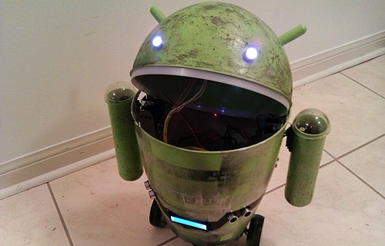
Routing planning
Condition statistics
Component analysis
Further Development Cont.

